Slide 1
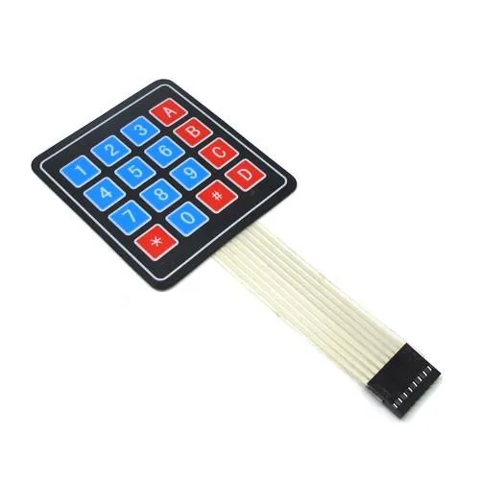
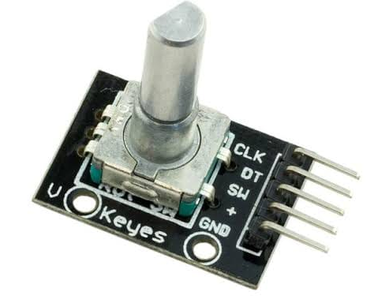
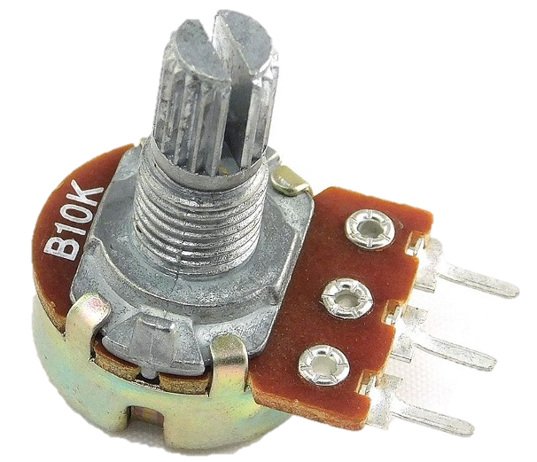
Arduino Session Four
Rotatory encoder, keypad, potentiometer (possibly relay and 7-segment display)

Slide 2
Session 3 – Recap
Control Generic DC motor using motor driver
Control Servo motor using Servo library
Read Reliably Push button

Slide 3
Session 4 – Main Objectives
Use Rotatory encoder
Door Controller
Use Keypad
Gate password lock

Slide 4
Session 4 – Optional Objectives
Use potentiometer and photoresistor
Auto night curtain
Mechanical door unlocker
Relay
Semi-smart Home lighting
7-segment display
First form of communication

Slide 5
Session 4 – Rotatory Encoder (Part 1)
What is rotatory encoder
How to interface incremental encoder
Project: Door Controller

Slide 6
What is encoder?
A rule for representing string of bytes, for example: character “A” is recognized/encoded in ASCII as 0b01000001
Also 0b01000001 is encoded in integer as 65

Slide 7
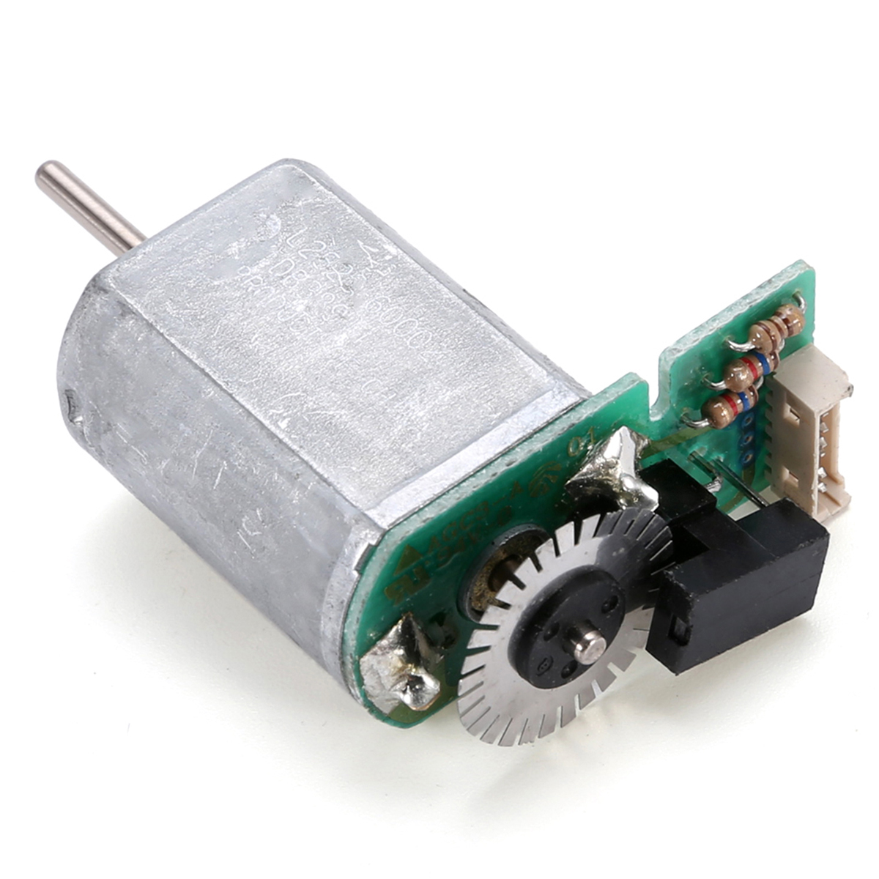
Rotatory Encoder
Encoding example: character “A” is recognized/encoded in ASCII as 0b01000001
Rotatory encoder is as the name suggest, but how it encodes the rotation or position

Slide 8
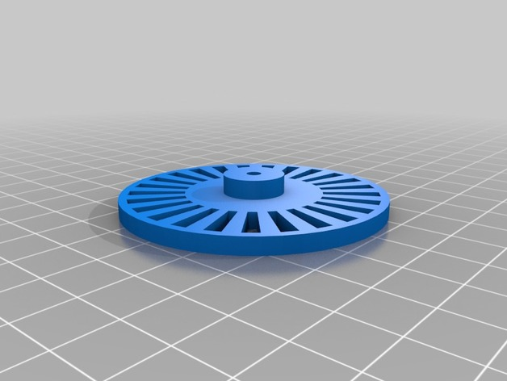
How Optical Rotary Encoder Works
The desired shaft to be encoded is connected to the encoder wheel

Slide 9
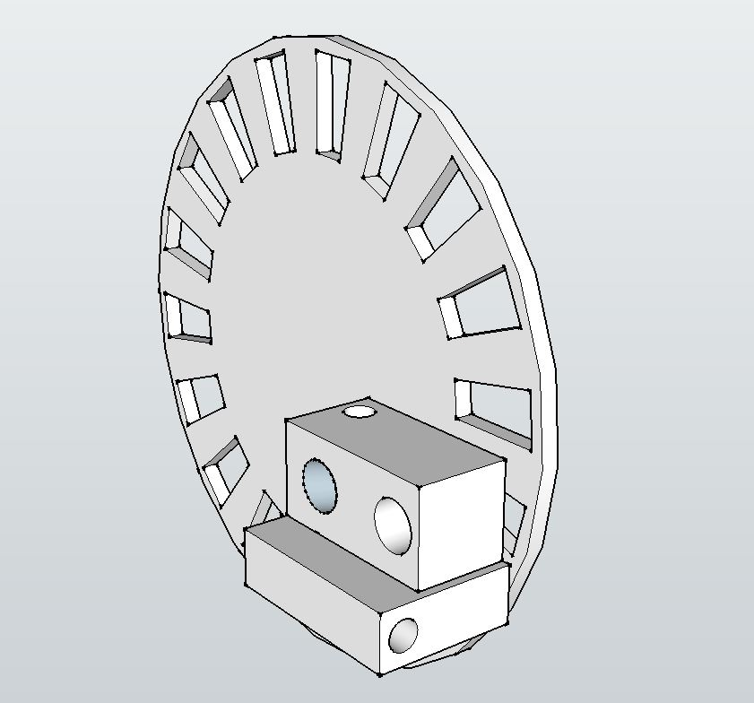
How Optical Rotary Encoder Works
The desired shaft to be encoded is connected to the encoder wheel
A LED is mounted on the extremity of the disk
A photodiode is mounted on the same extremity on the other side
Here is a 3D model of the concept

Slide 10

Other Types of Rotatory Encoders
Positional Encoder: based on the absolute position (angle of the disk)

Slide 11

Other Types of Rotatory Encoders
Positional Encoder: based on the absolute position (angle of the disk)

Slide 12
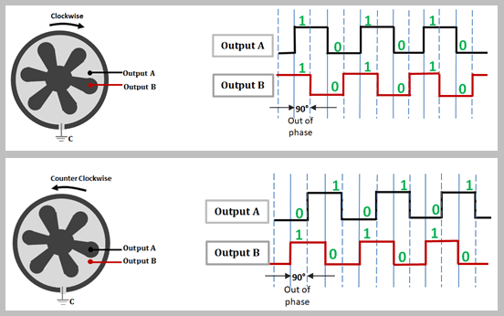
Actual Rotatory Encoder found in stores
Actual incremental encoders have two photodiodes to determine sense of rotation

Slide 13
How to read Encoder
Register reading cycle

Slide 14
Door Controller

Slide 15
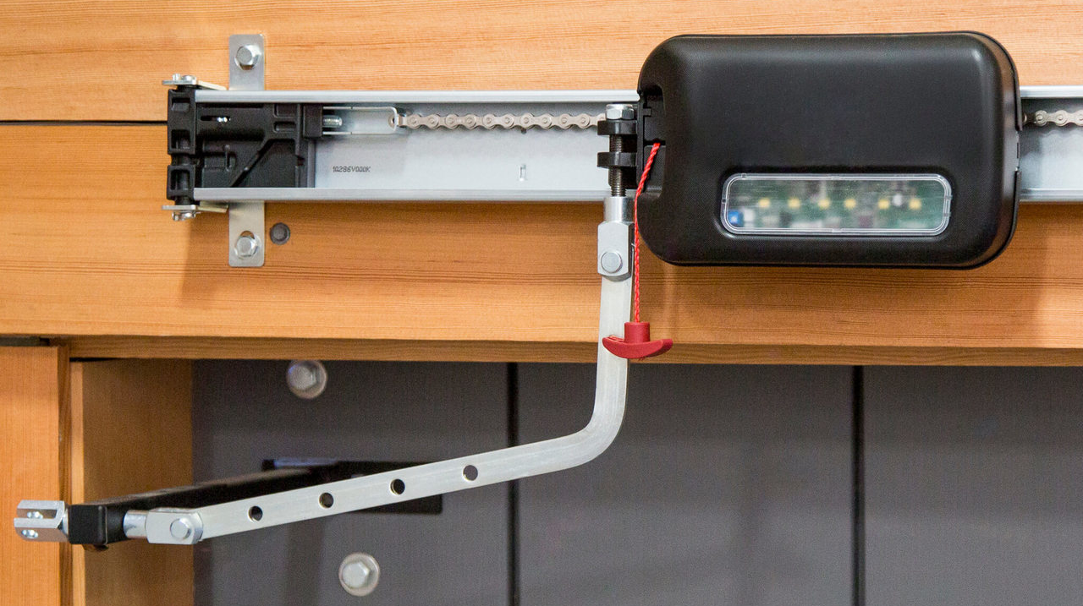
Semi – Auto Door Controller

Slide 16
Door Controller
2 Push buttons
1 for calibration
1 for user input
DC motor with encoder
Arduino

Slide 17
Door Controller – Program
In Initializing phase: The Arduino will boot up and calibrate the DC motor encoder (void setup)
The Arduino will keep closing the door till the calibration push button is pressed
We will agree that at this position the door is closed, and the door is opened 0 ticks
In the main Code (void loop)
We will monitor user input on push button 2
We have 3 procedure: stop whatever you are doing, close the door, open the door
We will monitor how much ticks the door is opened
If the door exceeds the maximum ticks (suppose 300 ticks), we will close the door

Slide 18
Door Controller – Wiring
2 push buttons with internal pull up resistors
1 DC motor connected to motor driver (l293d IC)
Arduino connected to motor driver
Channels of encoder connected to arduino

Slide 19
Door Controller – Variables
Code variables:
Current command (int):
1-> open door
2-> close door
3-> stop motors
Motor ticks (int):
0-> door is closed
200 -> door is fully opened
> 200 -> door needs to be closed

Slide 20
Door Controller – Procedure
If ticks > 210:
Close the door
If user input:
1 close the door
2 open the door
3 stop the motors
If push button 2 is pressed:
Increment user_input variable
If ticks in [200, 209] or ticks < 5 and pushbutton 1 is pressed
User_input = 3

Slide 21
Session 4 – Keypad (Part – 2)
How keypad is structured
How to interface Keypad
PIN code for our Door Controller

